Slide 1
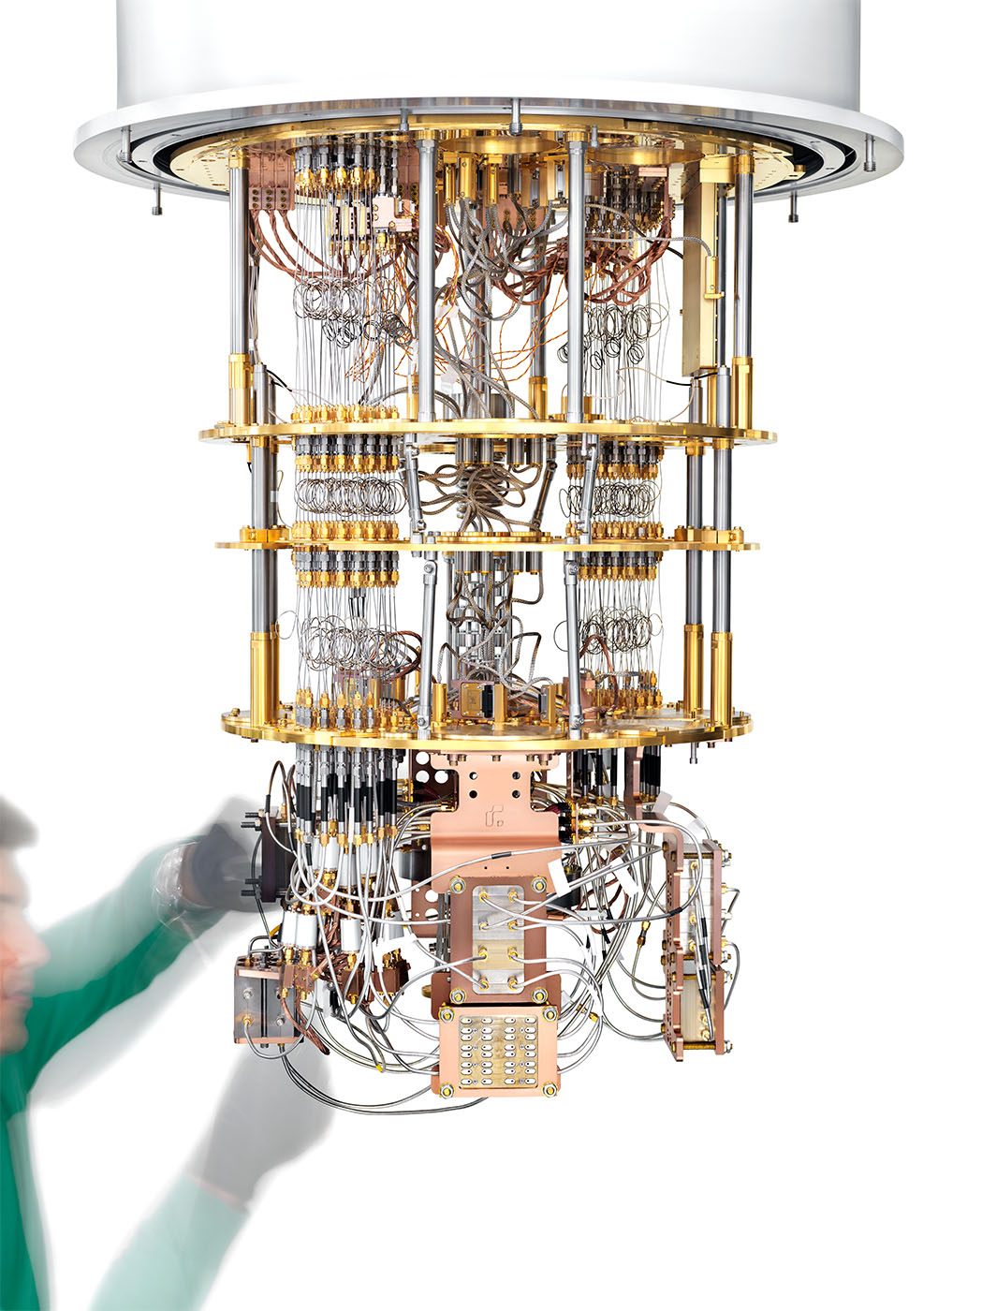
Quantum Computing SIG

Slide 2


Content Ideas:
Quantum Computing Courses
Invited talks
Hands on coding session
Coding on quantum hardware
Discussions
Develop quantum computing expertise at the center

Slide 3
Join us
Github: nlesc-sigs/QC-SIG: Quantum Computing SIG (github.com)
Outlook: qcsig@esciencecenter.nl
Teams: Quantum Computing SIG Teams

Slide 4
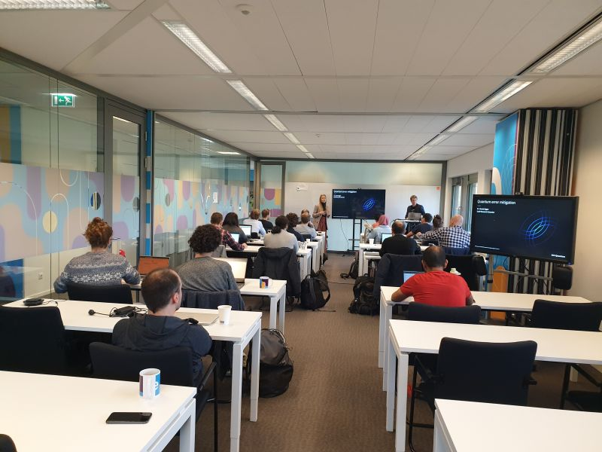
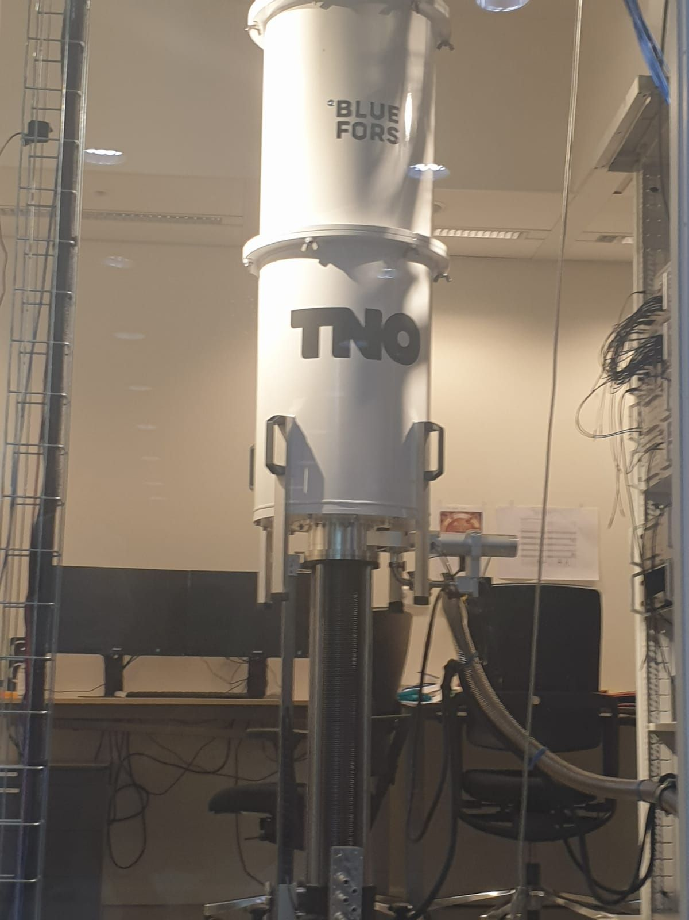

Quantum Application Lab
Launched on March 24, 2022
Consortium of many institutions
Bridge between science and applications
Regular workshops

Slide 5
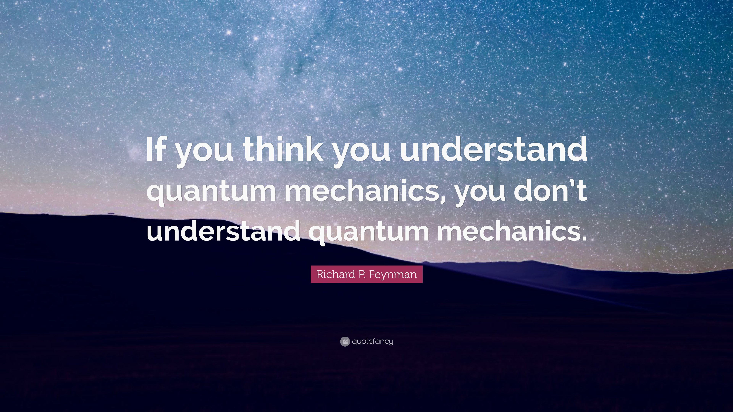

Quantum Computing
Contact Person
Pranav Chandramouli
p.chandramouli@esciencecenter.nl

